Slide 1
Online
Banking
Group - 4

Slide 2
Table of contents
01
Project
Introduction
02
Admin
Login
User
Login
03
04
Update
User-Profile

Slide 3
Table of contents
05
Loan
Requests
06
ChequeBook
Requests
07
Create
Account
08
WithDrawal
Deposit
Transaction
09
10
Our
Team

Slide 4
01
Project
Introduction

Slide 5
Online-Banking
The project simulates online banking system.
It allows user to register/login, deposit/withdraw money from accounts.
We can add/edit recipients, transfer money between accounts and recipients, view transactions.
We can requests for chequebook and loan, and on verification it’ll be approved by the Admin.

Slide 6
Advantages
It is a full-stack web application that uses Spring Boot for the backend, Angular for the frontend, and MySQL for the database. This means that it can handle both the business logic and the user interface of the online banking system, as well as store and retrieve data efficiently.
It uses Spring Security to implement authentication and authorization for the users and admins of the online banking system. This means that it can protect the sensitive information and transactions of the customers, as well as provide different levels of access and functionality for different roles.

Slide 7
Advantages
It uses RESTful web services to communicate between the backend and the frontend, as well as with external APIs. This means that it can support a modular and scalable architecture, as well as integrate with other applications and services easily.
It uses Angular to create a dynamic and responsive web interface for the online banking system, using components, directives, services and routing. This means that it can provide a better user experience and interaction, as well as support multiple devices and browsers.

Slide 8
02
Admin
Login

Slide 9
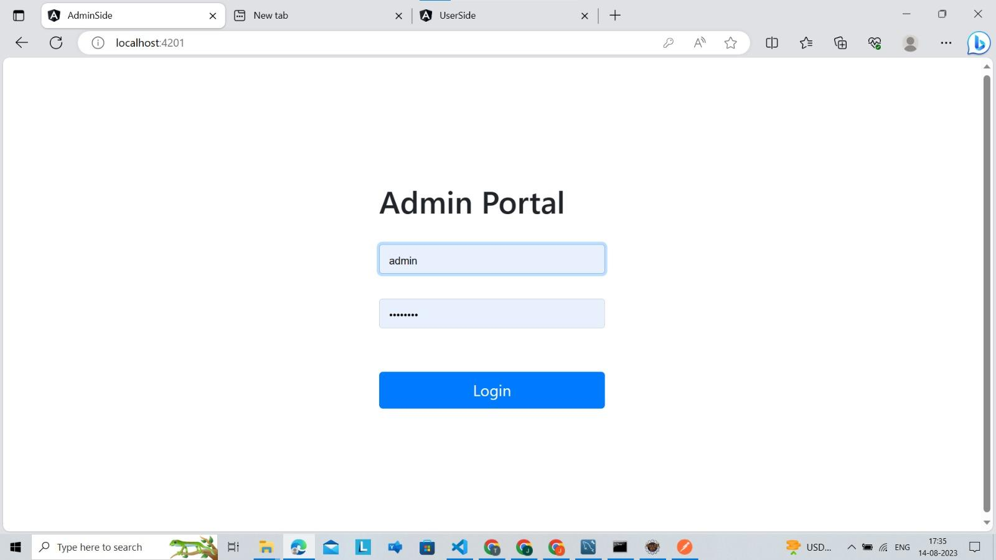
ADMIN LOGIN

Slide 10
ADMIN LOGIN
Admin login page helps the admin to login and track activities.
It uses Spring Security to implement authentication and authorization for the admins of the online banking system.
We have created a login form with input fields for both the username and password, includes validation for required fields, and provides error feedback to the user.
Angular service named Authentication service that handles user authentication and provides methods for checking login credentials, authenticating users, and managing the authentication state.
this service is responsible for handling user authentication based on the provided login data, and it manages the authentication state (isAuthenticated). It uses the Angular Router to navigate to different routes depending on the authentication status and provides methods to check and manage user credentials.

Slide 11
03
User Login

Slide 12
Login page is the gateway to any website's services.
It is crucial to have a user-friendly login page to provide a great user experience.
A simple login page design can reduce user frustration.

Slide 13
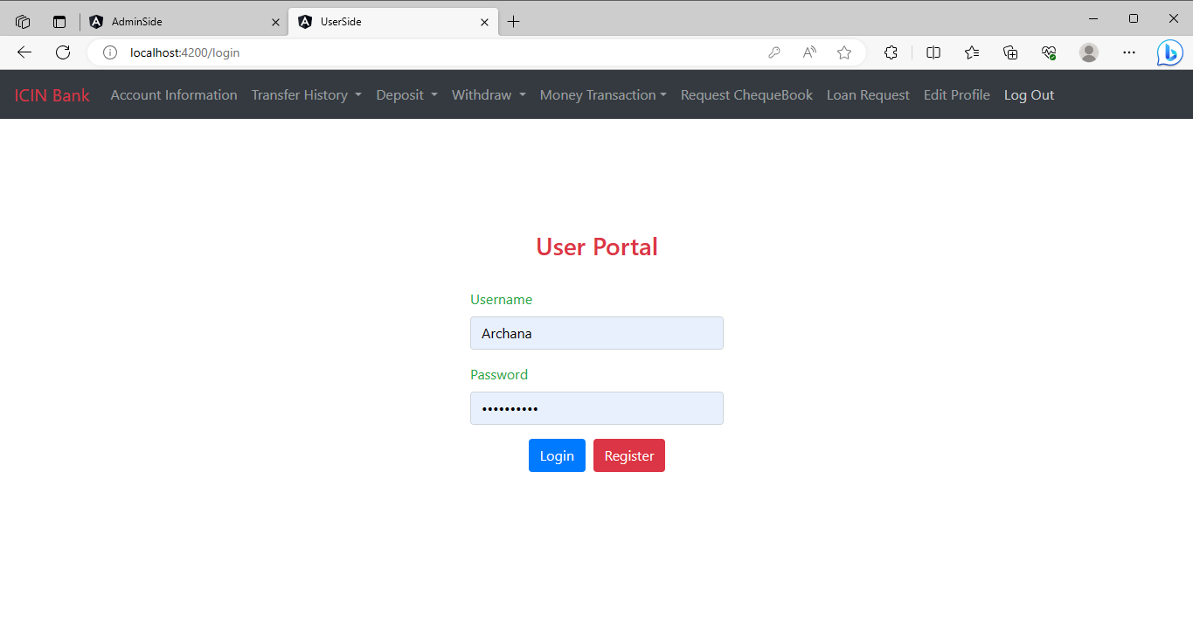
User Login

Slide 14
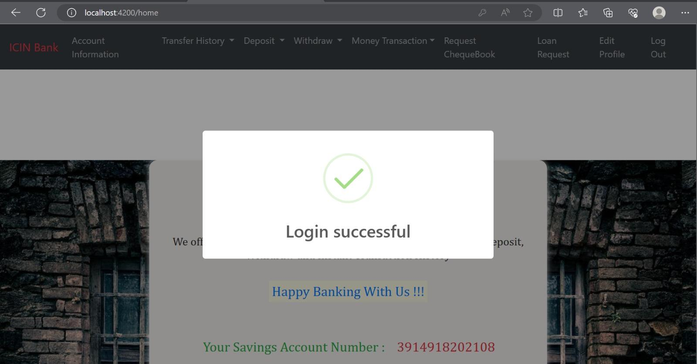
User login

Slide 15
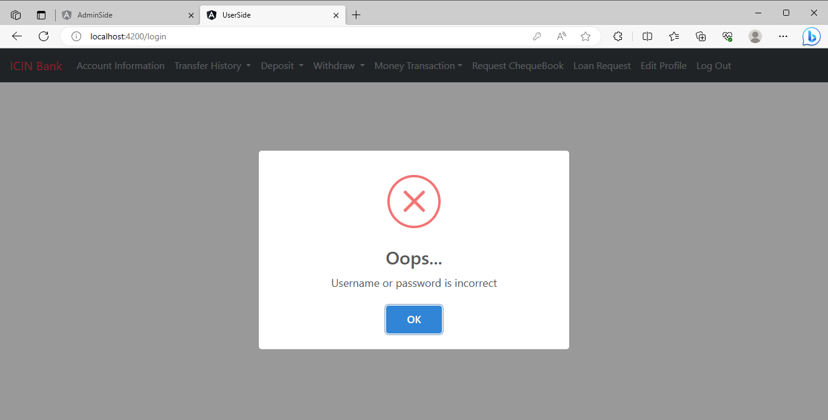
User login

Slide 16
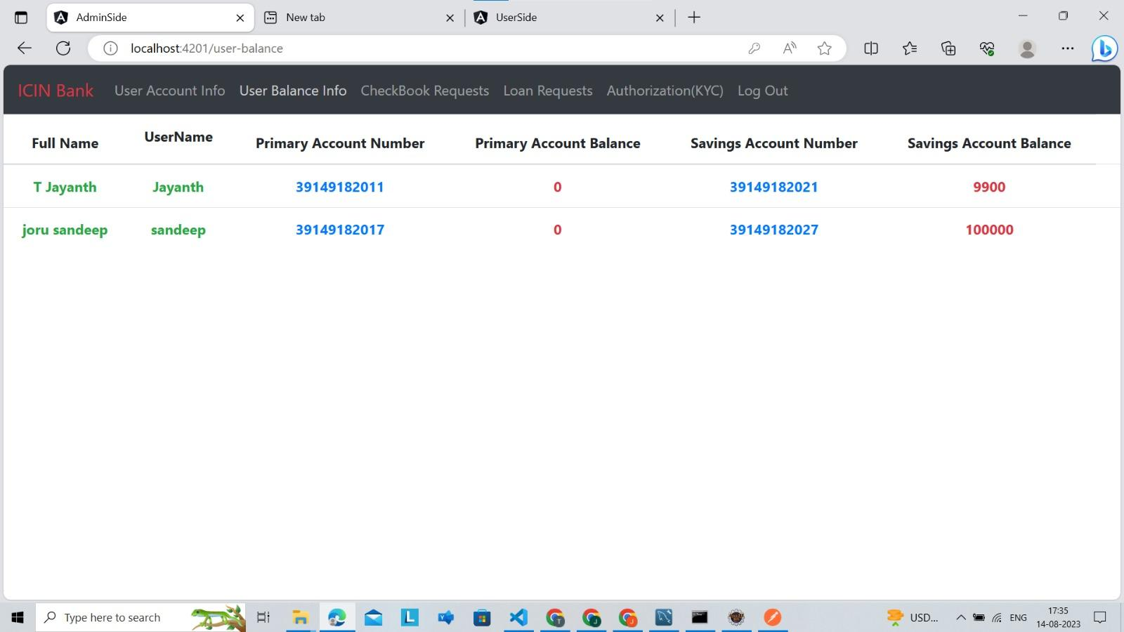
USER BALANCE

Slide 17
USER BALANCE
User can look for the balance in there account in this user balance info component.
User can track the amount remaining in there account here.
UserbalanceComponent that appears to manage user balance-related functionality and features. This component interacts with various services and handles user interface logic.
The UserbalanceComponent is intended to be used as a part of an Angular application and is responsible for managing user access levels and feature statuses related to user balances. It interacts with various services to enable/disable login and set user features based on the chosen access level.

Slide 18
04
Update User
Profile

Slide 19
Update User Profile
Personalization and Customization:
Users often want to personalize their experience on a web application to better suit their preferences.
Changing Information:
People's personal information can change over time. Allowing users to update this information ensures that their profile remains accurate and up to date.
Correcting Errors:
Users might make mistakes while initially filling out their profile information or uploading content. Allowing updates enables them to correct errors and provide accurate information.
Compliance and Accuracy:
In some cases, web applications might need accurate user information for compliance reasons. For instance, a financial platform might require accurate contact and identification information.

Slide 20
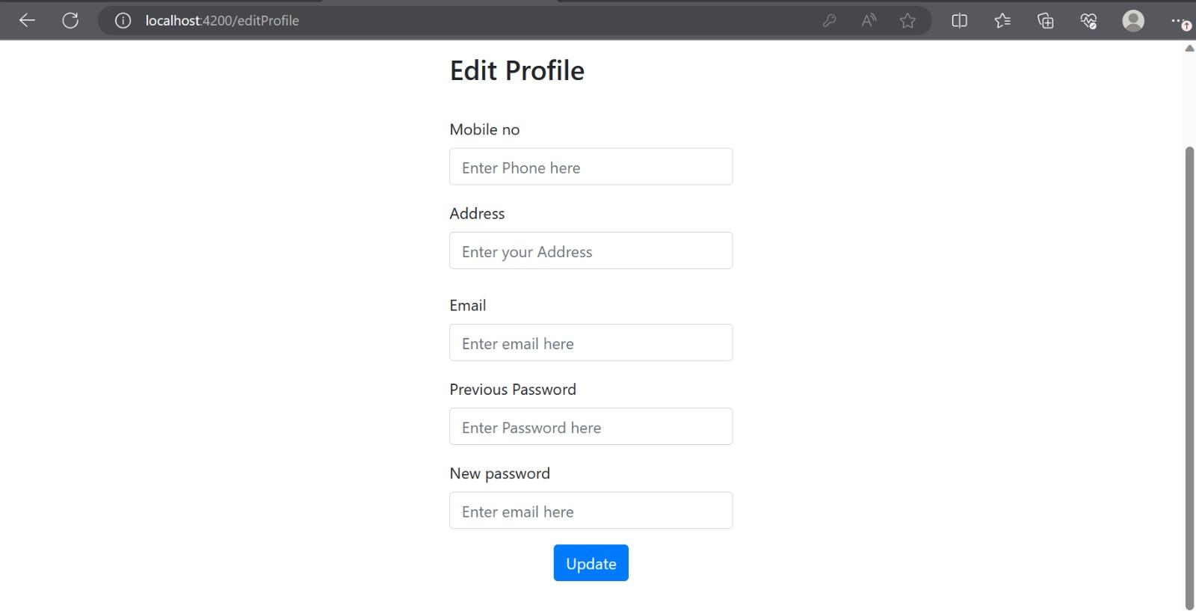
Update profile

Slide 21
05
Loan
Requests

Slide 22
Loan Requests
The loan-requests component is a part of the online-banking angular-spring project that allows the users to apply for loans.some advantage for online-banking angular-spring project
Using FormBuilder to maintain form for creating loan requests.

Slide 23
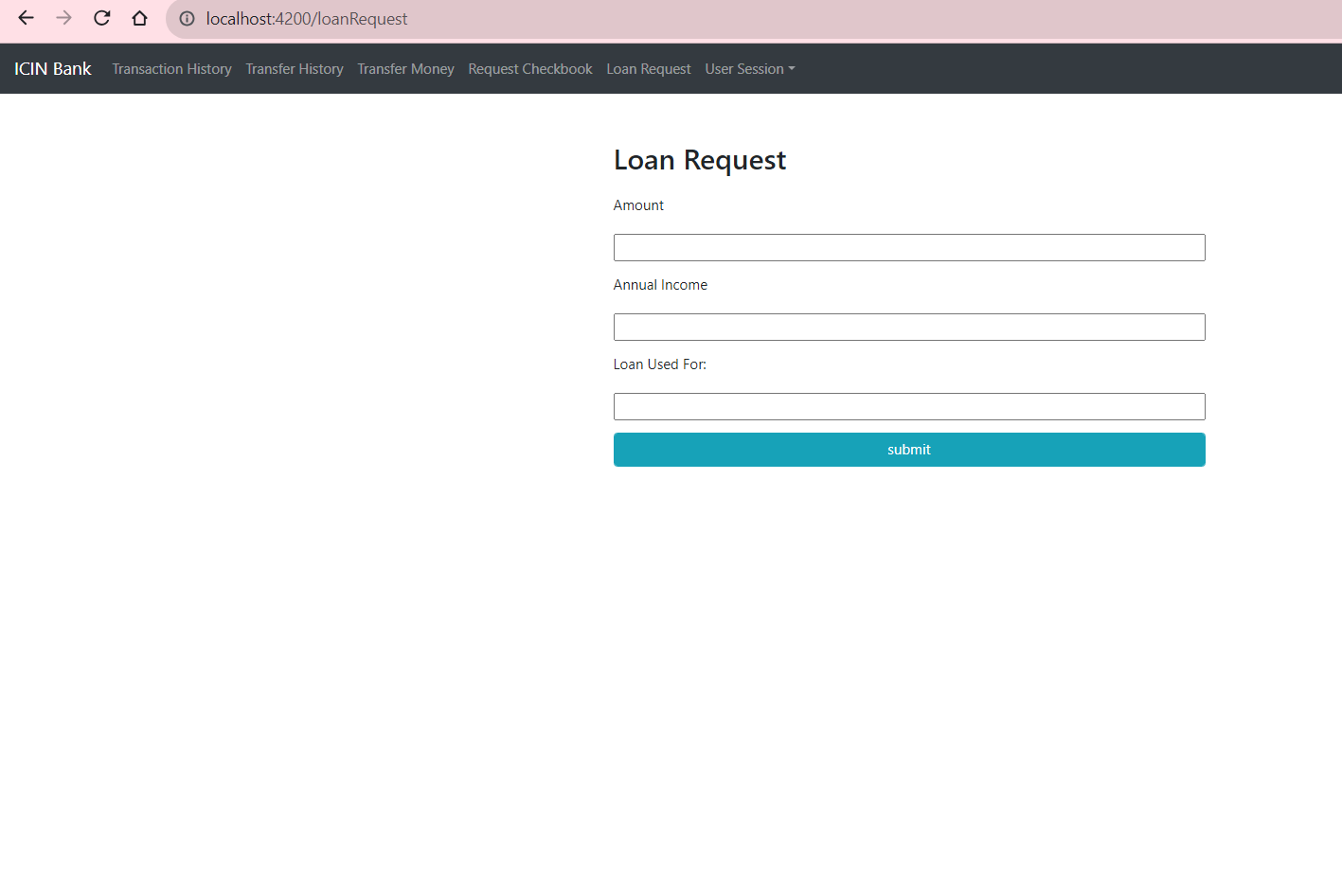
Loan Requests
A form that collects the customer’s personal and financial information, such as name, address, income, loan amount and loan purpose.

Slide 24
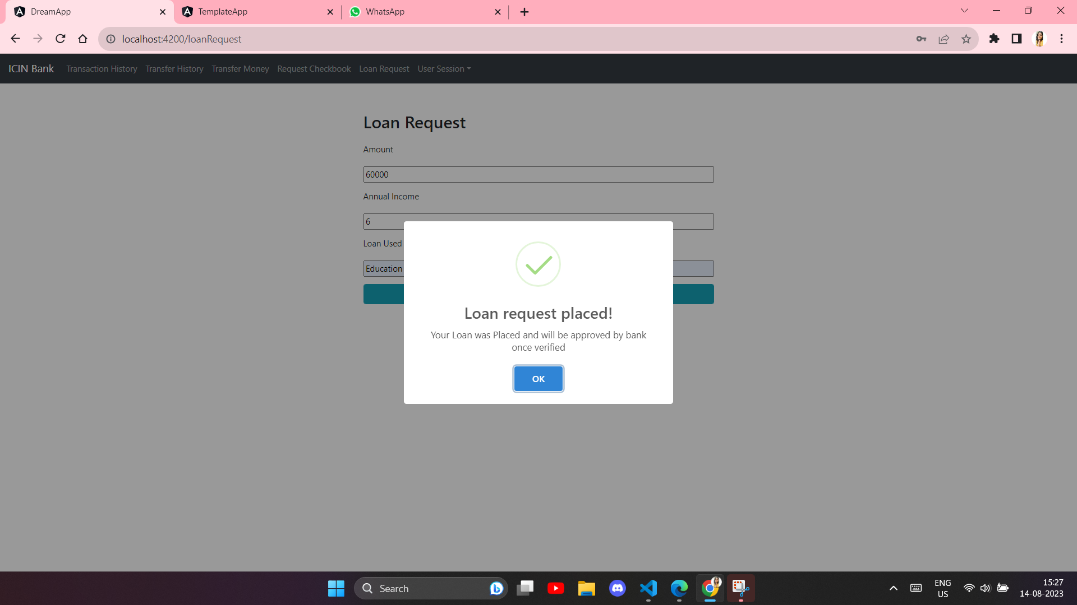
Loan Requests
A submission function that sends the loan request to the backend service using a POST method, and receives a response with the loan status and details.

Slide 25
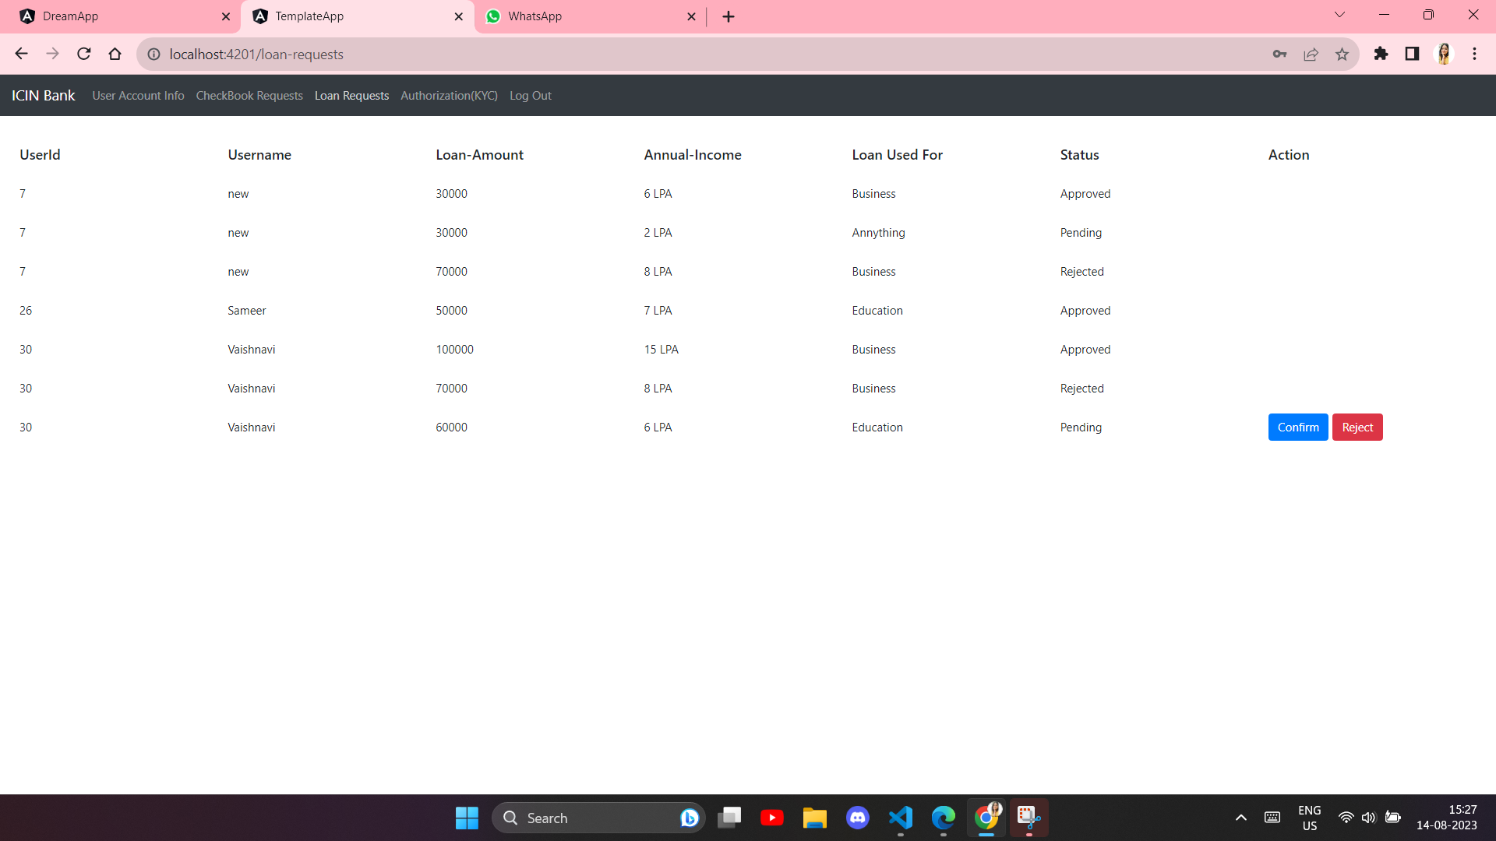
Loan Requests
Admin can view, approve or reject the loan requests.

Slide 26
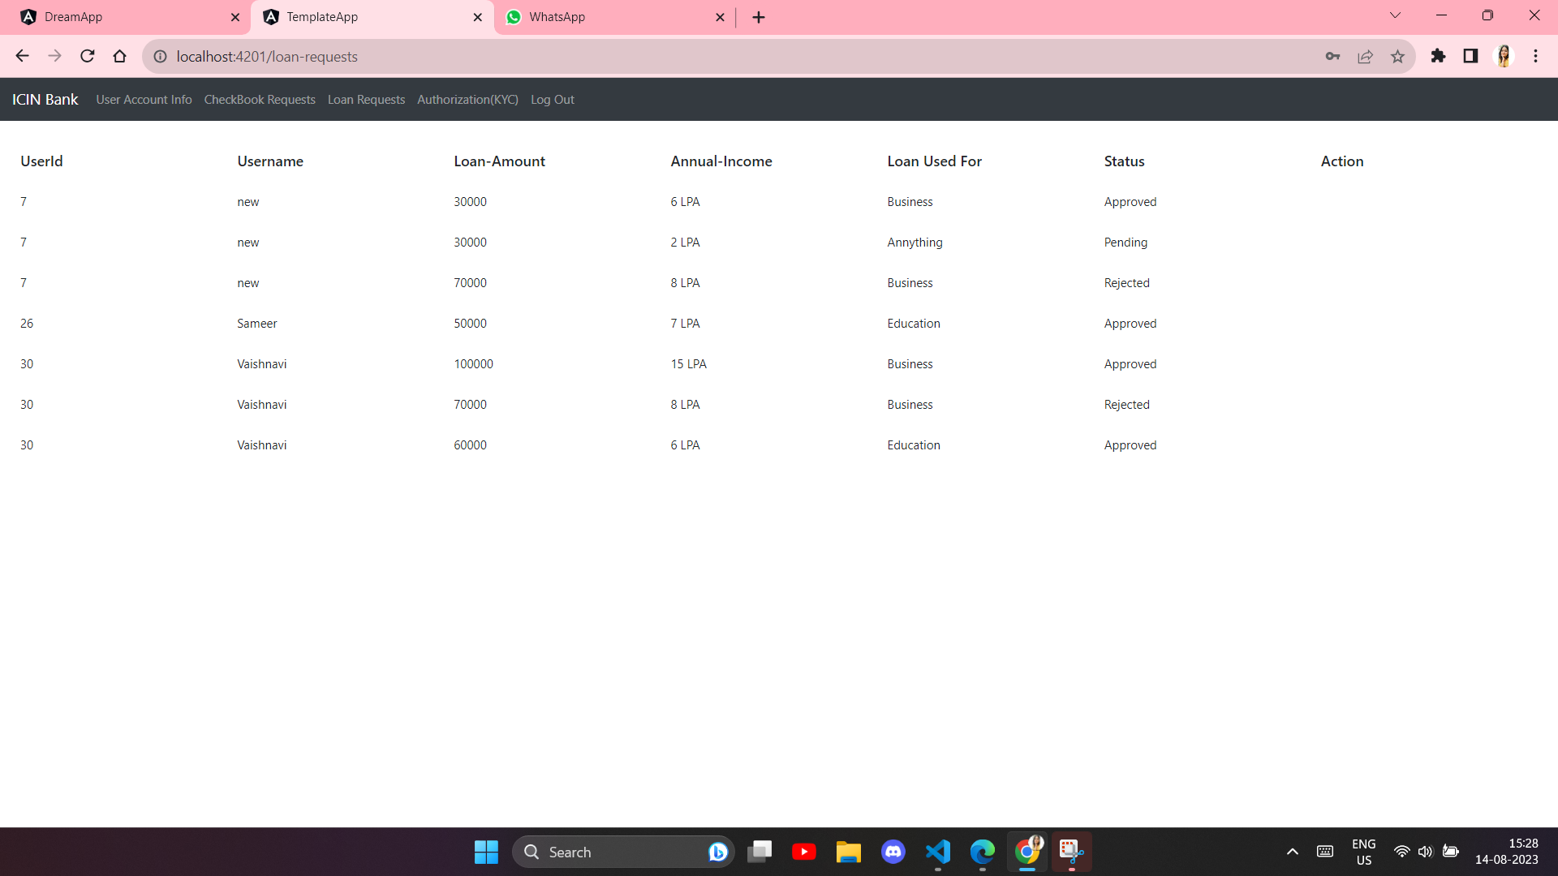
Loan Requests
List of all the approved and
Rejected loans.

Slide 27
06
ChequeBook-
Requests

Slide 28
User Portal: Requesting a Cheque Book
Navigation: Users can easily navigate to the "Request Checkbook" section from the main menu of the user portal.
Account Selection: Users are prompted to select the account for which they want to request a checkbook. The account number is displayed prominently to avoid confusion.
Number of Pages: Users can choose the number of pages for their checkbook from a dropdown menu. Options include 20, 50, and 75 pages.
Submit Request: Once users select the account and number of pages, they can submit their request by clicking the "Request Chequebook" button.
Feedback: After submitting the request, users receive immediate feedback. If successful, a success message is displayed. In case of any issues, an error message is shown.
Admin Portal: Confirming Chequebook Requests
Request List: Administrators can access the admin portal, where they are presented with a table listing pending checkbook requests.

Slide 29
2. Table Columns: The table displays essential details for each request, such as the request number, account type, account number, applied date, and the number of pages requested.
3. Confirmation: For each pending request, administrators can confirm by clicking the "Confirm Request" button. This action updates the request status and signifies that the request has been processed.
Technical Implementation: Frontend and Backend
User Portal (Frontend):
The user portal interface is built using Angular, providing an intuitive user experience.
Users select their account and desired number of pages from dropdowns.
Upon clicking the "Request Chequebook" button, a loading spinner appears while the request is processed.
Success or error messages are displayed based on the API response.
Admin Portal (Frontend):
The admin portal, also built with Angular, offers an organized view of pending checkbook requests.
Administrators can confirm requests by clicking the respective buttons, triggering API calls for backend updates.

Slide 30
3. User and Admin Portals (Backend):
The backend is developed in Java and utilizes Spring Boot.
User and admin requests are handled separately.
User requests include account number and page count, while admin requests update request statuses.
Database Interaction:
The system stores checkbook requests in a database, maintaining details like account number, requested page count, and request status.
Key Benefits:
Users can conveniently request checkbooks online, enhancing user experience.
Administrators have a streamlined process to manage and confirm requests.

Slide 31
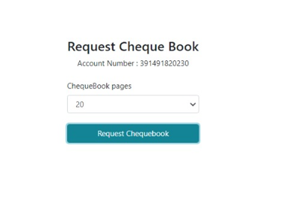
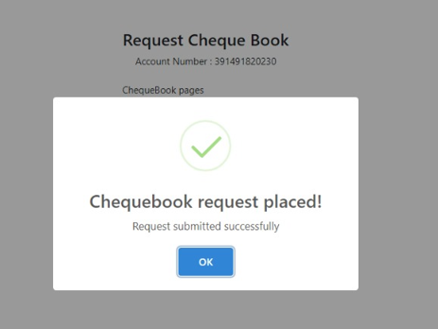
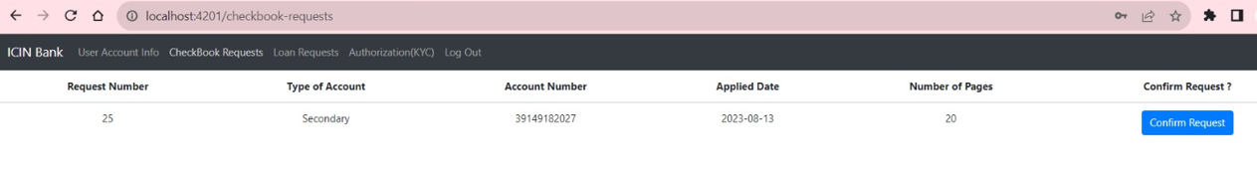
Screenshots:
User:
Admin:

Slide 32
07
Create a
Account

Slide 33
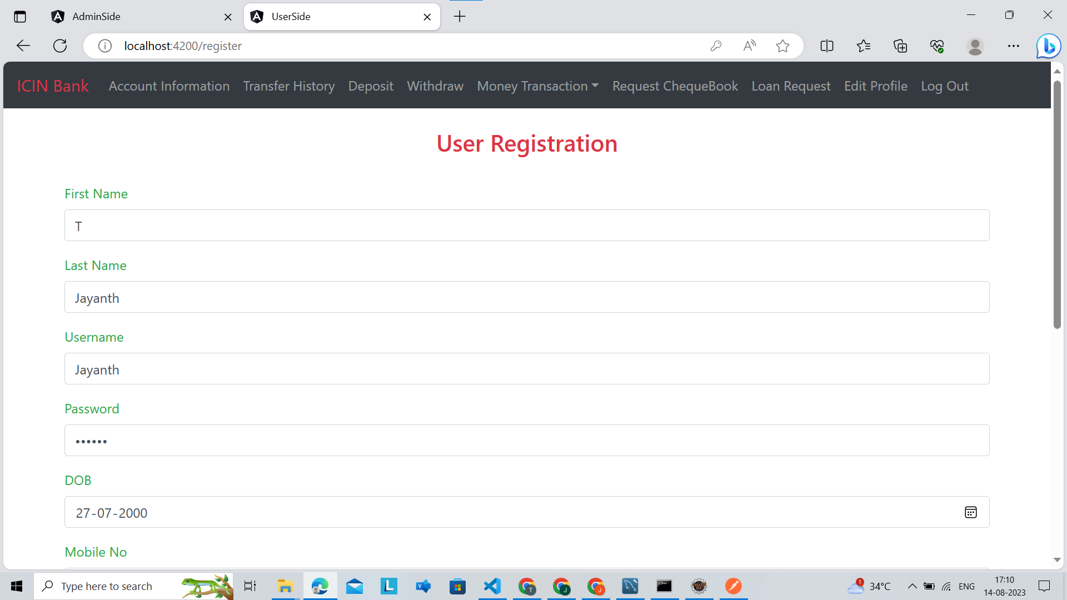
Creating account

Slide 34
To create an account, users must complete the application form provided.
After filling out the application, the KYC (Know Your Customer) details will be subject to approval by the admin.
Until the admin approves the KYC, the account will not be activated.
It's essential for every user to undergo the KYC verification process, overseen by the admin, for account creation.
Upon successful KYC validation by the admin, the user will gain full access to their account

Slide 35
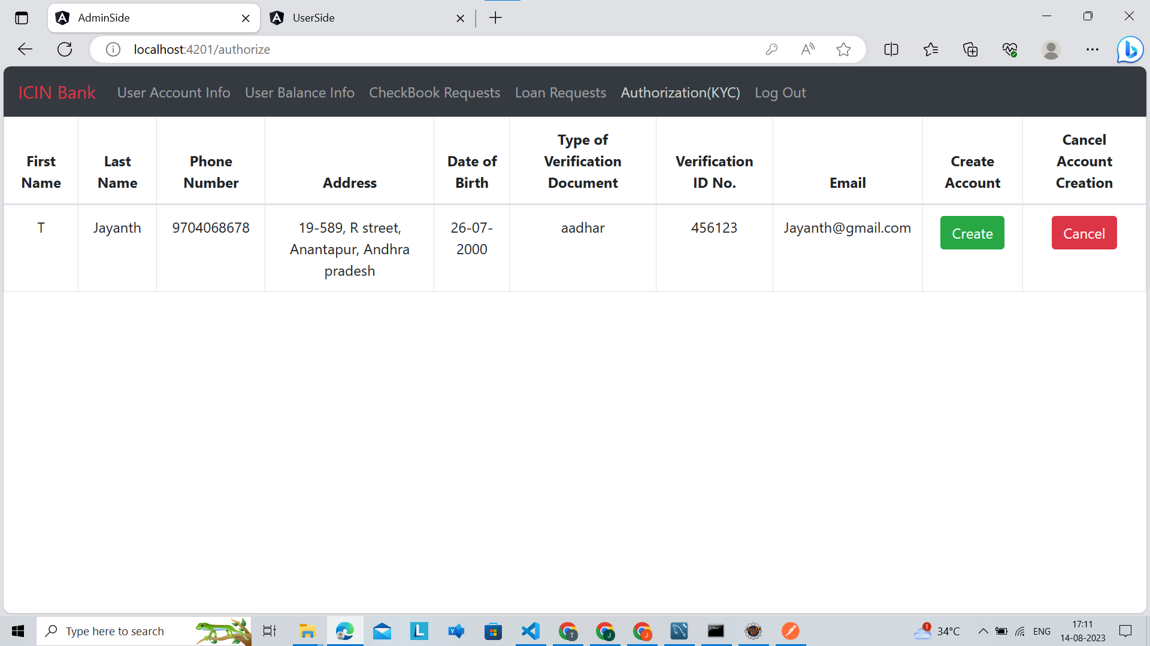
User database is created in backend to save all the user details

Slide 36
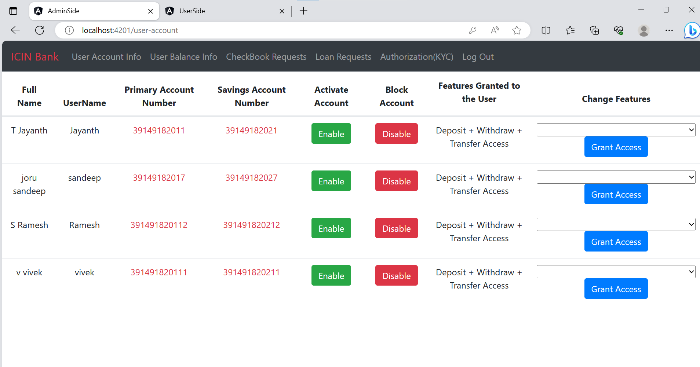

Slide 37
08
Withdrawal/
Deposit

Slide 38
Deposit
In the Online-Banking, Deposit Component is present it is used that a user can successfully deposit any amount to their own Primary and Savings Account.
After Depositing Money it shows that money is successfully deposited to their own account and also shows the updated balance for that account.
In the Navigation Bar the Deposit Option is Present.

Slide 39
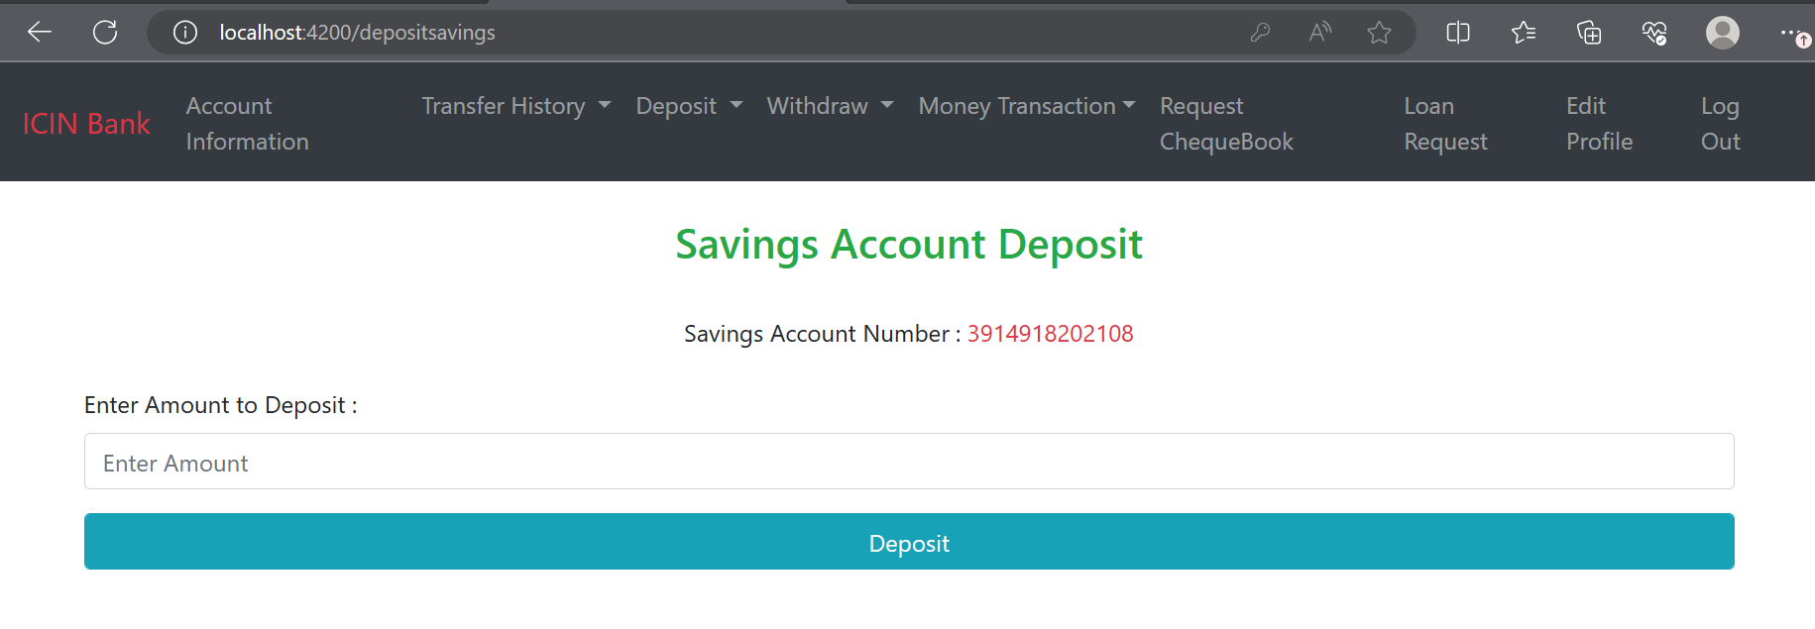
Deposit
The Account Holder can enter the amount and Deposit to the Savings Account

Slide 40
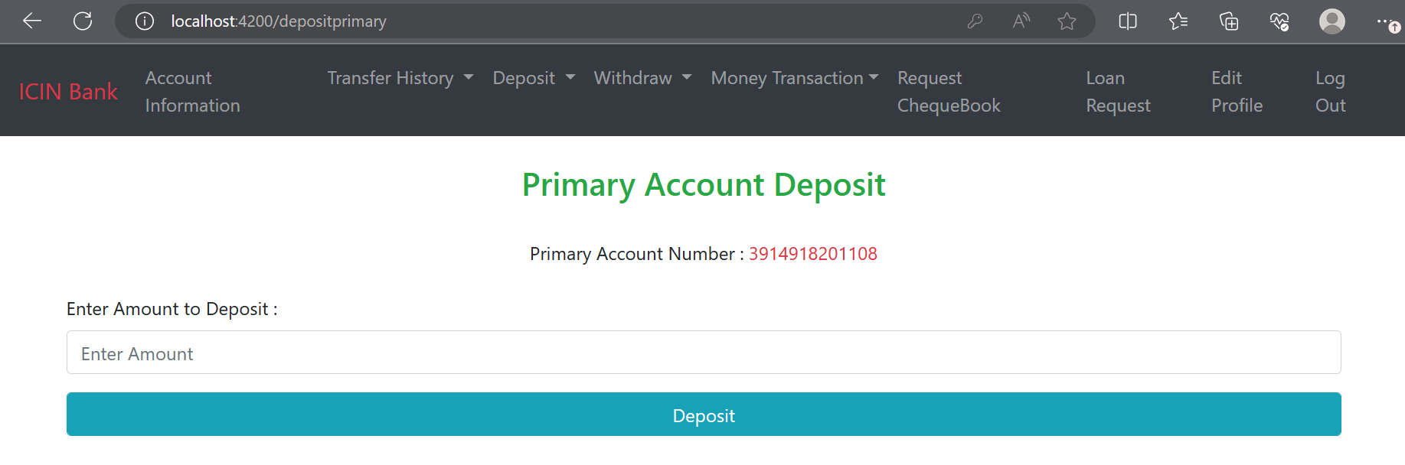
Deposit
The Account Holder can enter the amount and deposit to their Primary Account

Slide 41
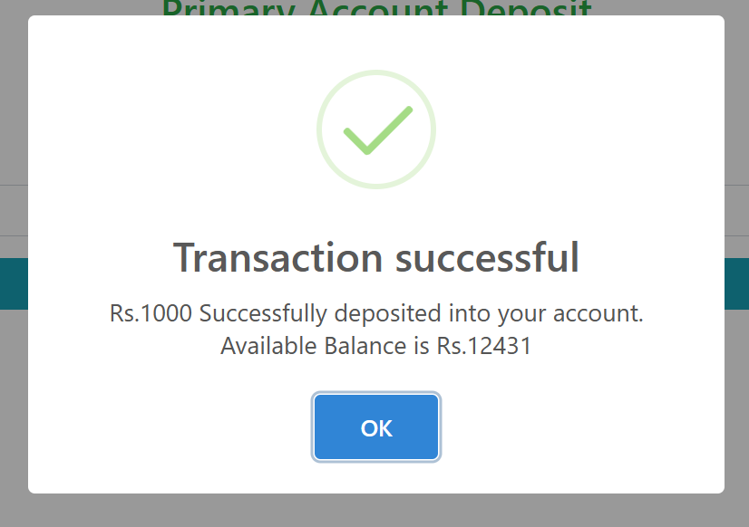
Deposit
After Successfully Depositing money to the account the user can able to see
the message:

Slide 42
Withdrawal
In the Online-Banking, Withdraw Component is present it is used that a user can successfully Withdraw any amount from their own Primary or Savings Account.
After Withdrawing Money it shows that money is successfully Withdraw from their own account and also shows the updated balance for that account.
If the Withdrawal amount is greater than available balance it shows error message.
In the Navigation Bar the Withdraw Option is Present.

Slide 43
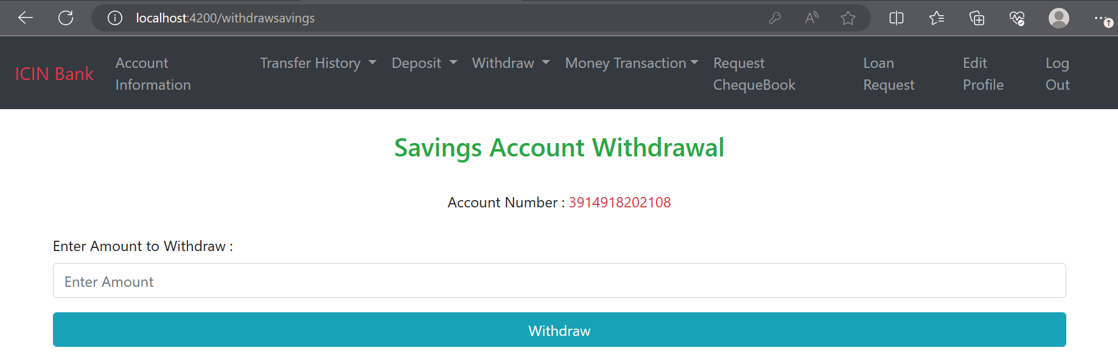
Withdrawal
The Account Holder can enter the amount to withdraw from their savings or primary account and can withdraw

Slide 44
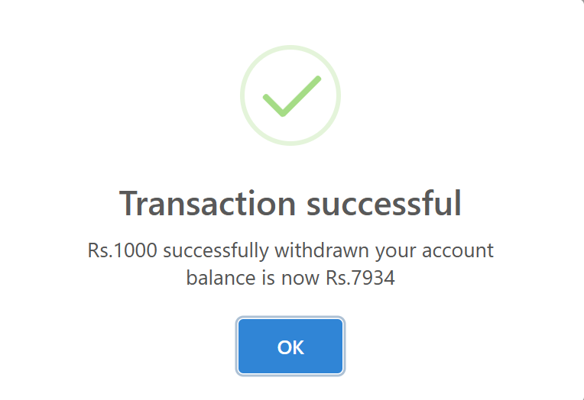
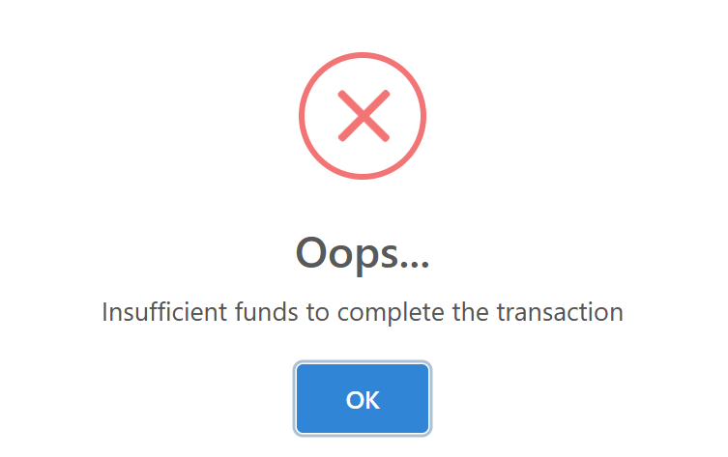
Withdrawal
After Successfully Withdraw money from the account the user can able to see the message:
If the money withdrawing is greater than the account balance it shows the error message:

Slide 45
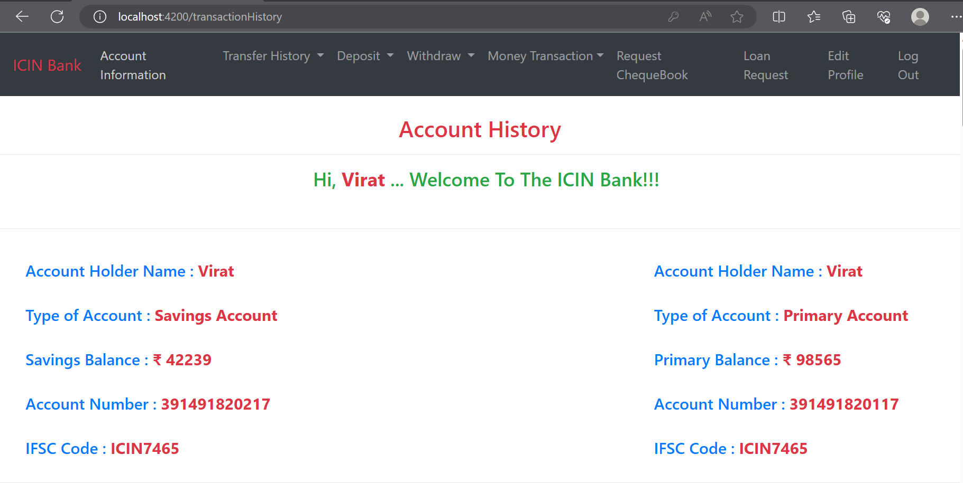
Account Balance - Deposit,Withdraw
After Depositing and Withdrawing Money User Can be able to see the Updated Balances for both accounts in the Account Information Page.

Slide 46
09
Transactions

Slide 47
Transactions
Transactions play a important role in our banking system project as they ensure consistency and reliability of financial operations.
Designed to handle fund transfers between accounts in a banking system.
Users have the flexibility to make transactions seamlessly between their primary and savings accounts.

Slide 48
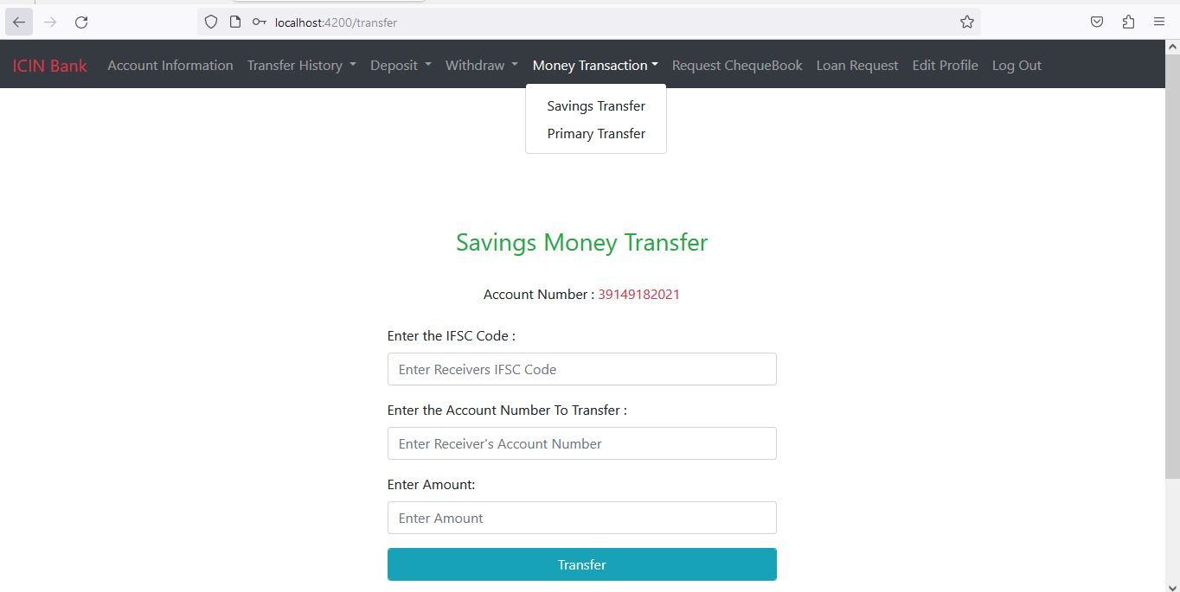
Transaction page

Slide 49
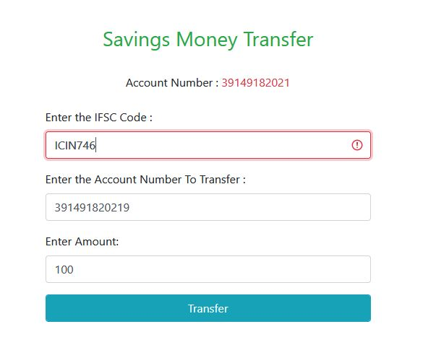
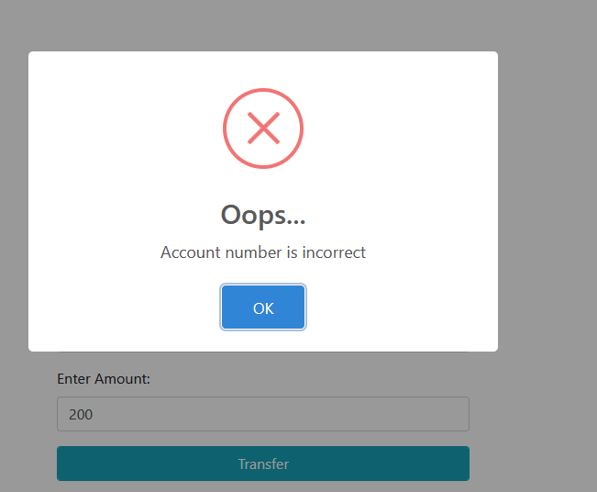
The form begins by verifying if the provided IFSC code matches a predefined value.
If the IFSC code is incorrect, the form generates a response indicating the error
The method then checks if the account number matches an account in the database, If the account is valid, It will transfer.
The method generates a response indicating the error as account number is incorrect.

Slide 50
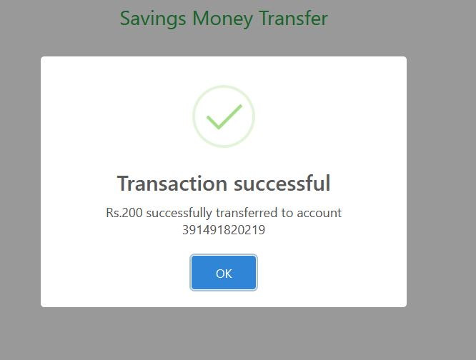
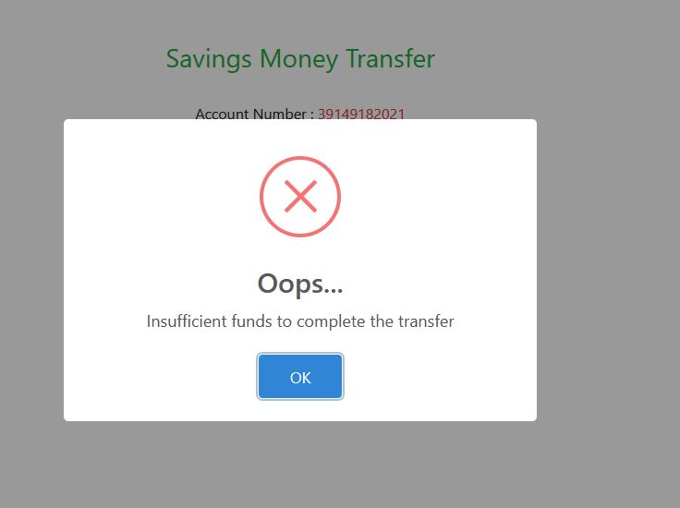
User need to enter the amount to transfer and need to click on the transfer button
The transferred amount is deducted from the sender's account and credited to the receiver's account.
If the user has insufficient funds in the account, generates an error response indicating “insufficient funds to complete the transfer”

Slide 51
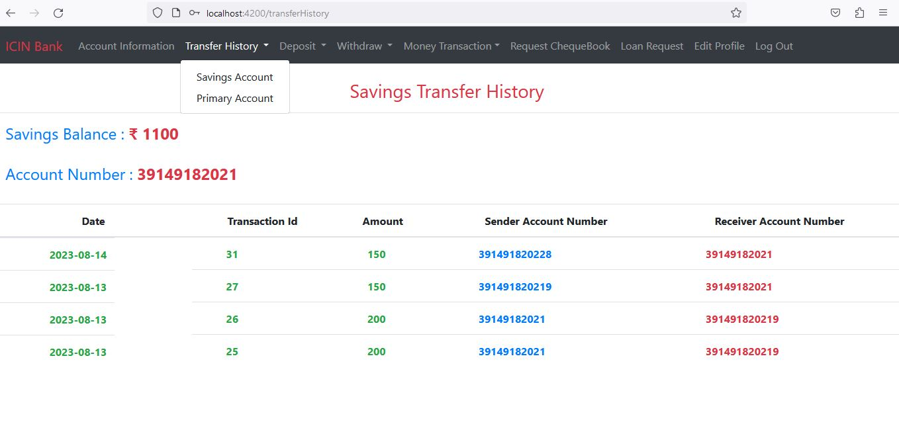
Transaction List

Slide 52
At the user's end, the transaction list displays a table containing transaction records to the specific user. These records has details of sender and receiver account numbers, transaction dates and transaction Id.
At the Admin end, the admin able to see the list of transaction records of all the users. The list has the details of sender and receiver account numbers, transaction dates and Id.

Slide 53
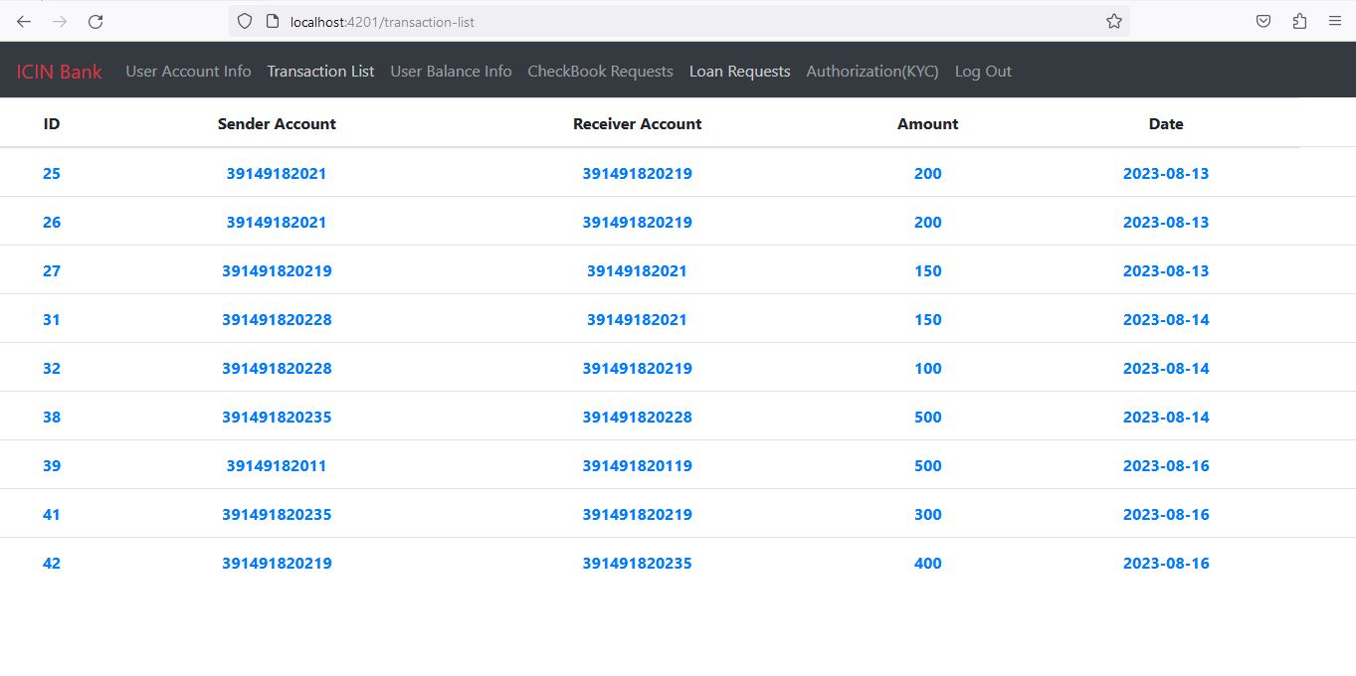
Admin-Transaction List

Slide 54
10
Our
Team

Slide 55
Our Team
Sarthak Srivastava
Vaishnavi Srivastava
Team Leader
Stain thomas
Boby Sebastian
Thota Jayanth
Sriharinivaishnavi S
Joru Sandeep

Slide 56
Thanks!

